Slide 1
Text Mining Analysis of Drug Reviews for Enhanced Patient Care
Group 6 :
Pooja Jhooria
Riya Choudhury
Sai Sharan Reddy Chettupally
Tarun Sai Babu Polavarapu
Usha Sree Dindi
1
Notes:
Entered text
Introduction
In the healthcare sector, patient feedback on medications is a rich but underutilized resource that can significantly contribute to the improvement of patient care and medication outcomes. Despite containing critical insights into medication efficacy, side effects, and patient satisfaction across various conditions, this feedback is often vast, unstructured, and not systematically analyzed. This presents a major challenge for healthcare providers and researchers aiming to enhance patient care and medication development. The problem lies in the need for a comprehensive approach to effectively mine and analyze these patient reviews, particularly focusing on metabolic diseases such as diabetes, which have widespread impact on populations worldwide.
Entered text
Dataset introduction
The dataset titled "Drug Review Prediction" on Kaggle contains patient feedback on various medications, aimed at facilitating the analysis of patient experiences and opinions on their treatments. It's structured to support research into how patients perceive the effectiveness and side effects of their medications, without a specific focus on sentiment analysis. This data is crucial for enhancing patient care and guiding pharmaceutical development by providing insights into patient perspectives.

Slide 2
Introduction
Patient feedback on medications is a rich but underutilized resource in healthcare.
However, this feedback is often vast, unstructured, and not systematically analyzed.
It can contribute significantly to the improvement of patient care and medication development.
This presents a major challenge for healthcare providers and researchers.
A comprehensive approach is needed to effectively mine and analyze patient reviews.
2

Slide 3
AGENDA
Dataset Introduction and Source
Challenges
Problem Statement
Text Analysis Approach
Text Modelling
Model Comparison
Conclusion
Business Insights
3

Slide 4
DATASET INTRODUCTION
The "Drug Review Prediction" dataset on Kaggle comprises patient feedback on medications, designed to help analyze and understand patient experiences with their treatments.
The dataset contains over 3500 drugs for varying health situations, over 200,000 observations, 4 attributes, and tens of thousands of texts by users of their experience.
Drug Name: Identifies the medication reviewed.
Condition: Specifies the medical condition treated by the drug.
Review: Textual feedback provided by the patient.
Rating: Numerical rating given to the drug by the patient.
Source : https://www.kaggle.com/datasets/oladayoowoeye/drug-review-prediction-sentiment-analysis
4

Slide 5
Challenges in Analyzing Patient Feedback
Patient feedback is often vast, unstructured, and difficult to analyze.
There is a need for systematic analysis methods and tools.
The focus of this presentation is on metabolic diseases like diabetes and obesity.
5

Slide 6
PROBLEM STATEMENT
Our business problem statement was to tackle the challenge of analyzing unstructured patient feedback on medications, focusing on metabolic diseases.
Managing dataset complexity by narrowing the analysis to diabetes and obesity as the disease focus.
Categorizing reviews into positive, negative, or neutral for analysis.
Analyzing reviews with medication as the target variable.
Aiming to clarify the relationship between patient feedback and medication efficacy.
Seeking actionable insights for improving care and medication development.
6

Slide 7
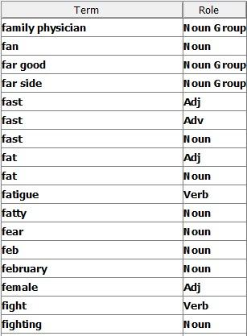
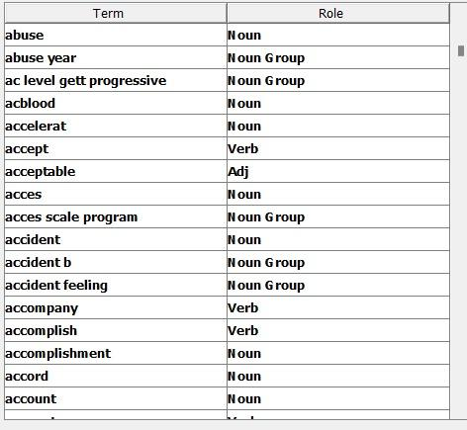
TEXT ANALYSIS APPROACH
Optimized the stop list by allowing all the words to parse through to text filter and observed it through interactive filter viewer
For Diabetes
For Obesity
7

Slide 8
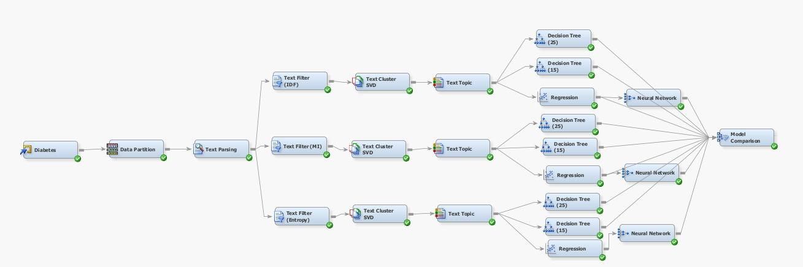
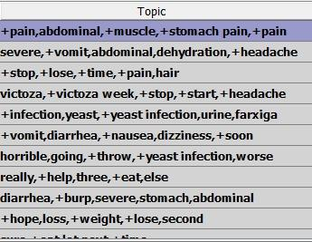
TEXT MODELLING FOR DIABETES
8

Slide 9
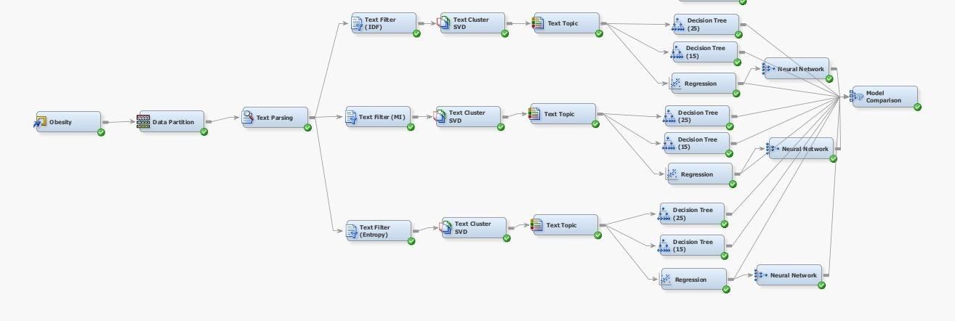
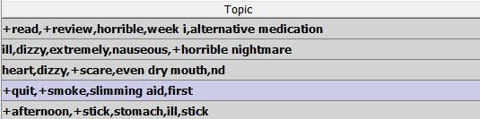
TEXT MODELLING FOR OBESITY
9

Slide 10
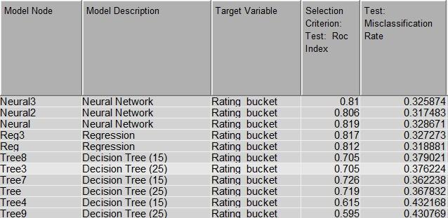
MODEL COMPARISON FOR DIABETES
Performance summary of various models
Best Model : NEURAL 2 with highest ROC index of 0.806 and lowest Misclassification rate of 0.317
10

Slide 11
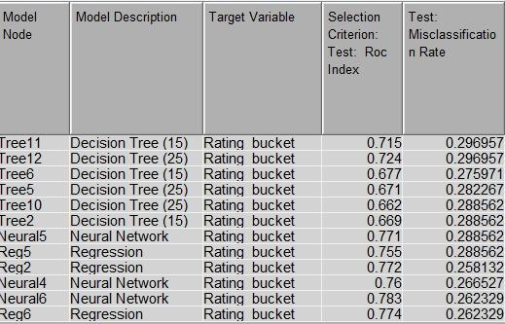
MODEL COMPARISON FOR OBESITY
Performance summary of various models
Best Model : REG 2 with highest ROC index of 0.77 and lowest Misclassification rate of 0.258
11

Slide 12
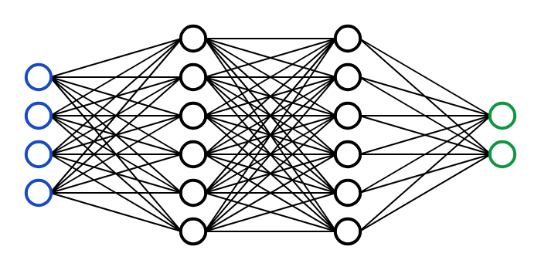
CONCLUSION
In the analysis of predictive models for rating drug feedback, Neural Network models outperformed others, demonstrating superior classification ability with lower error rates.
The efficacy of neural networks in processing and making accurate predictions from patient feedback data suggests their strong potential in sentiment analysis applications.
12

Slide 13
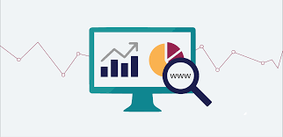
BUSINESS INSIGHTS AND RECOMMENDATION
From a business standpoint, this indicates a significant opportunity to apply neural networks for analyzing customer sentiment and feedback.
By doing so, businesses can gain precise understanding of consumer opinions, leading to more informed decisions in product development, marketing strategies, and customer service enhancements.
For the case of diabetes, the topic weight was highest for the neutral patient feedback with side effect like abdominal pain, muscle pain, stomach pain etc while for obesity highest topic weight was observed for positive patient feedback with side effect like dizziness, nausea, dry mouth etc.
13

Slide 14

QUESTIONS?
And THANK YOU!
14

